Slide 1
Homework #2 (Discussion)
Plot the TS diagram using the TS data (1st column is the temperature data, 2nd column is salinity data) given in the link below:
https://drive.google.com/file/d/1tg4gAYZfMwjMSsJOkWwiYIByy2X9gnQR/view
The given temperature and salinity data are obtained from an observation executed in an open ocean. Guess where the observation was executed, in the Pacific or the Atlantic. Explain why?
Send your work in a docx word file (filename: hw02_yourname.docx)
to https://driveuploader.com/upload/lVD4ycOKfP/

Slide 2
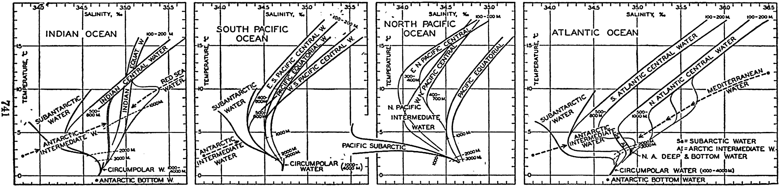
Discussion
Pacific | Atlantic | Others (NaN)
0 | ALL | 0
查網路
Referring to the figures shown in below:

Slide 3
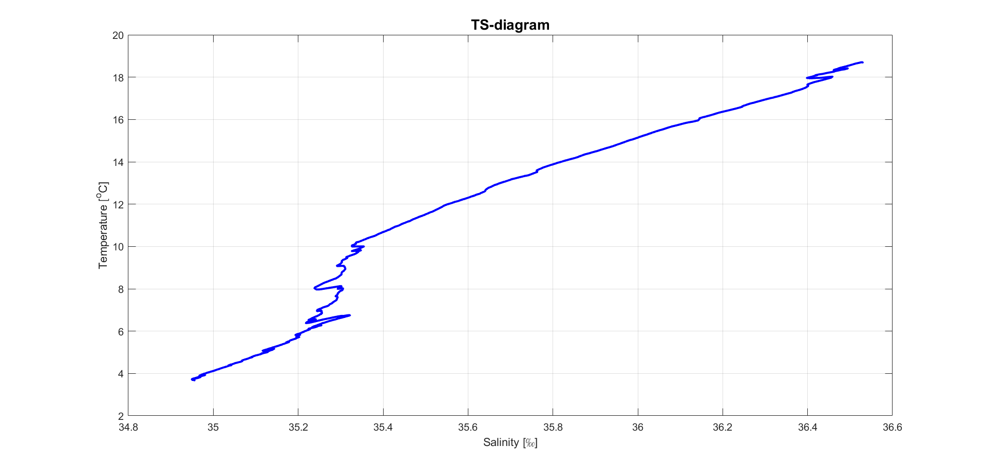

Slide 4
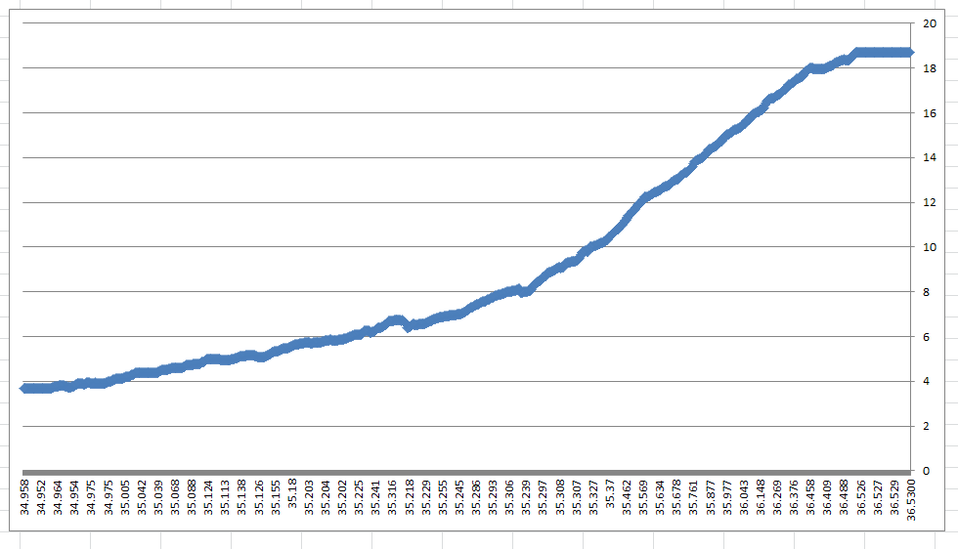

Slide 5
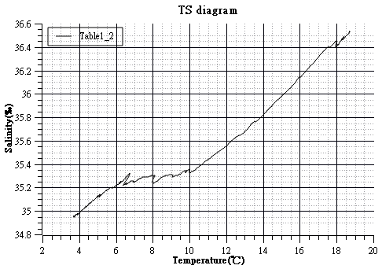

Slide 6
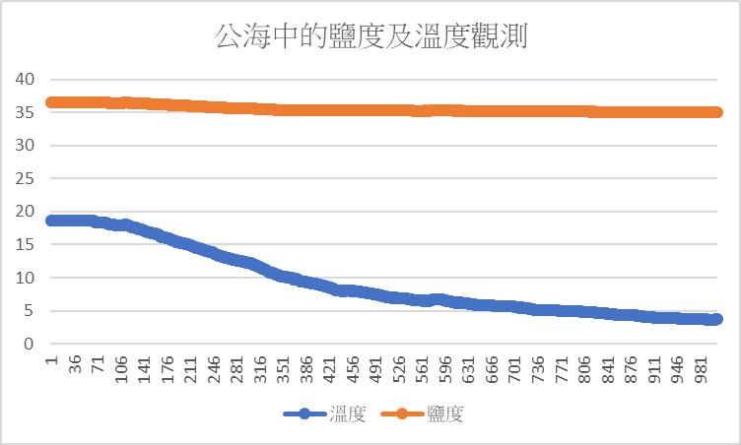

Slide 7
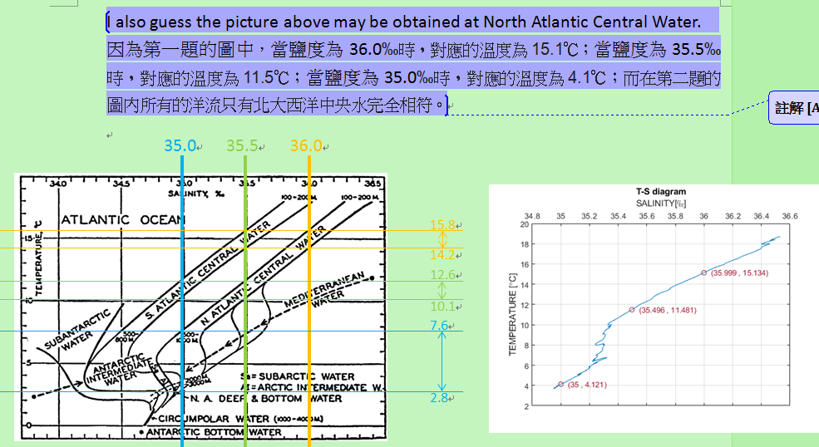

Slide 8

1082 洋流觀測分析 line群組
https://line.me/R/ti/g/p3nlQBYWcP

Slide 9
Some methods of observing ocean currents
Methods of observing currents:
In-situ and satellite/remote-sensing observations

Slide 10
What methods that you know to observe ocean current?
Discussion
測量海流時可觀測哪些參數?
如何量測海流?

Slide 11
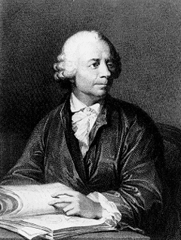
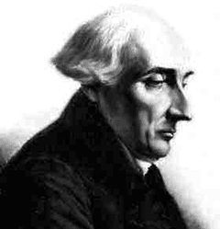
Two major types of measurements for ocean currents
Lagrangian (拉格朗日) measurements
Eulerian (歐拉) measurements
Joseph Louis Lagrange (1736-1813) the first mathematician to describe the path followed by fluids.
Leonhard Euler (1707-1783)
the first mathematician to describe the speed and direction of a fluid as it passes a single point in space.
Notes:
http://oceanservice.noaa.gov/education/kits/currents/07measure1.html
(No copyright found)

Slide 12
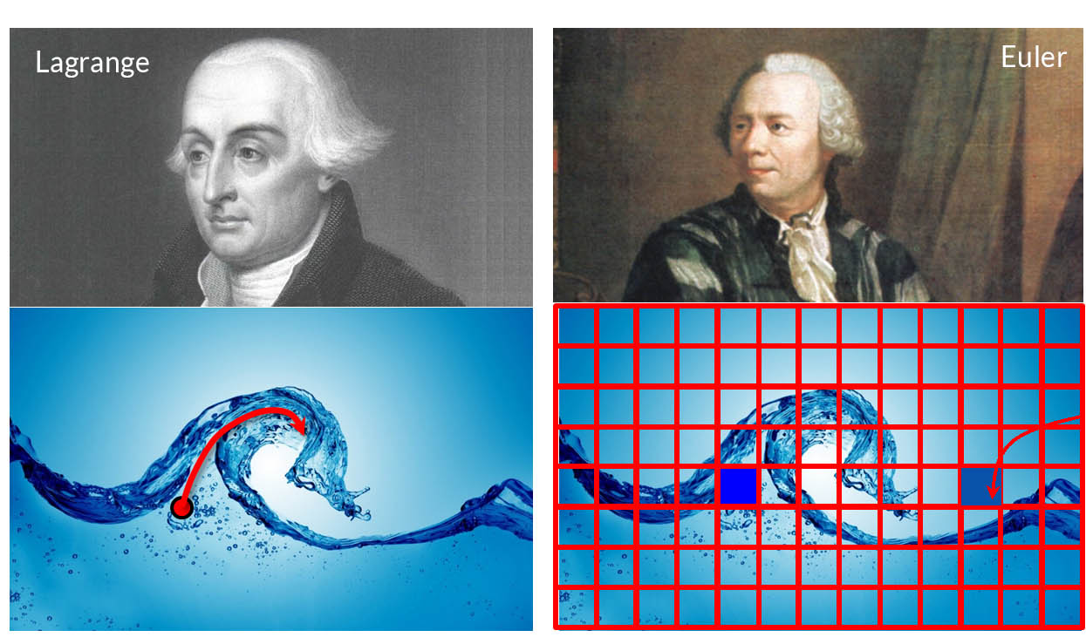
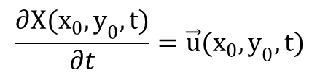
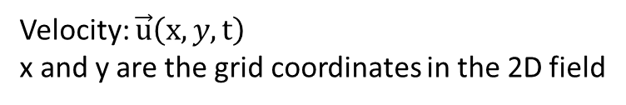
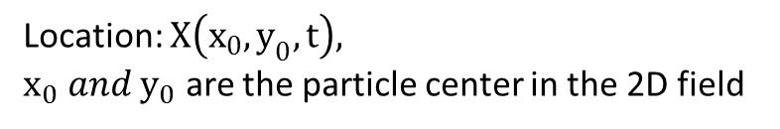
Location: $X\left(x_{0},y_{0},t\right),$
$x_{0} and y_{0}$ are the particle center in the 2D field
Velocity: $\vec{u}\left(x,y,t\right)$
x and y are the grid coordinates in the 2D field
$$\frac{∂X(x_{0},y_{0},t)}{∂t}=\vec{u}(x_{0},y_{0},t)$$
Notes:
http://hoskere2.web.engr.illinois.edu/cs445/finalProject/
(No Copyright found)

Slide 13
Lagrangian Measurements
Drifters

Slide 14
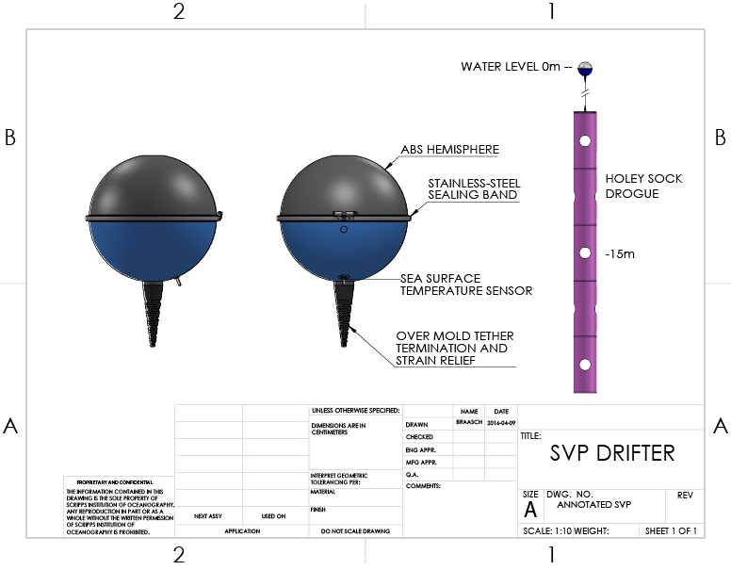
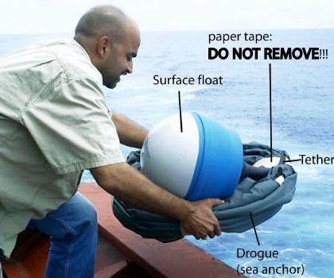
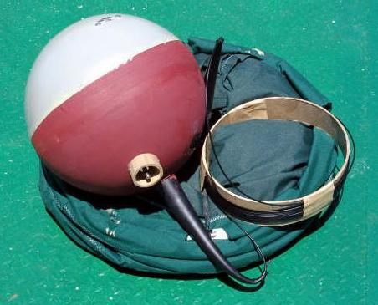
ARGOS drifter
https://gdp.ucsd.edu/ldl_drifter/instruments/svp.html
www.nodc.noaa.gov
Notes:
No Copyright found

Slide 15
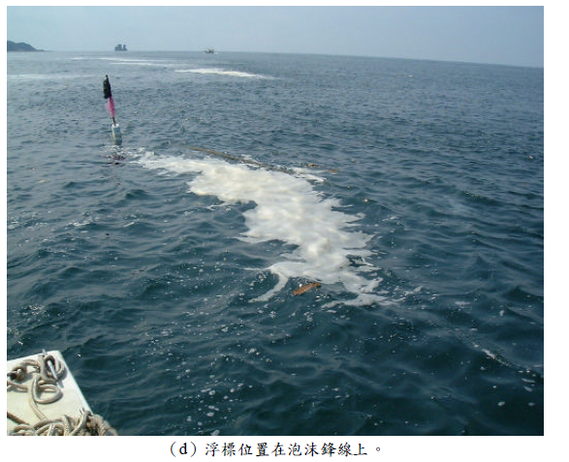
Lagrangian Observation
臺灣北部近岸海流與海灣形狀之關係
–核電廠溫排水動態之個案研究 [張俊鋐, 2002]

Slide 16
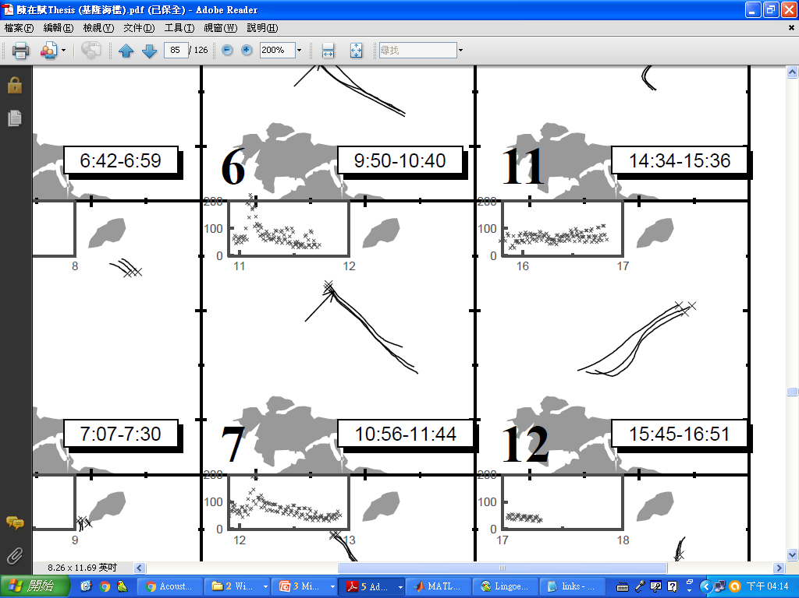
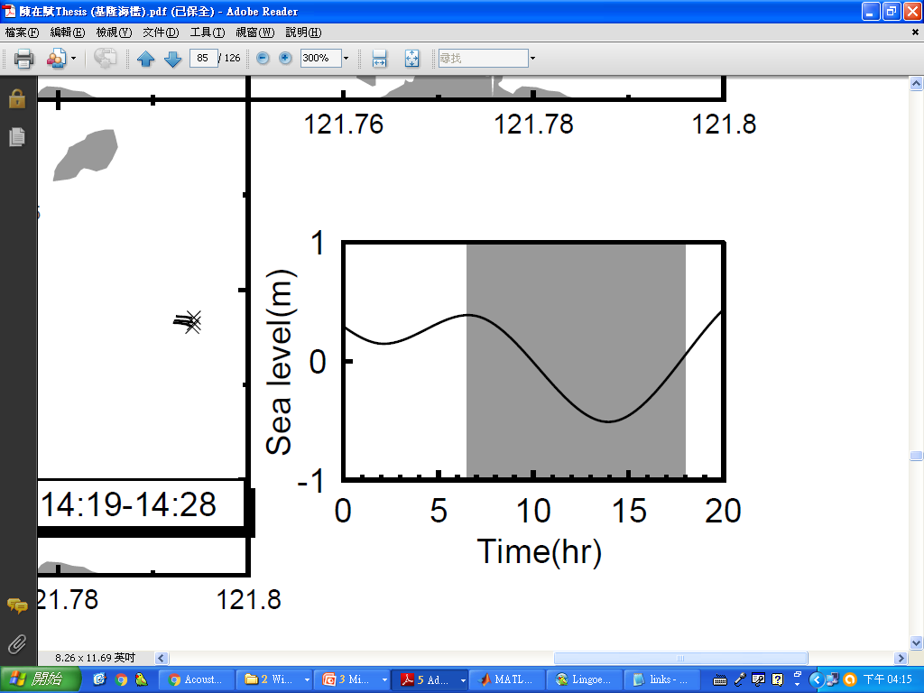
"spaghetti" plot/ current chart
海洋大學 陳在賦 (2004) 碩士論文

Slide 17
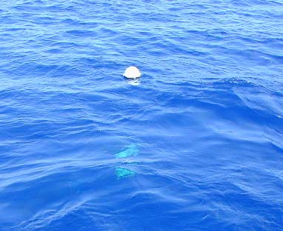
Showing "spaghetti" plot/ current chart
http://oceancurrents.rsmas.miami.edu/atlantic/gulf-stream_2.html
https://oceancurrents.rsmas.miami.edu/atlantic/spaghetti-bw/gulf-stream.jpg
Velocity = Distance / time

Slide 18
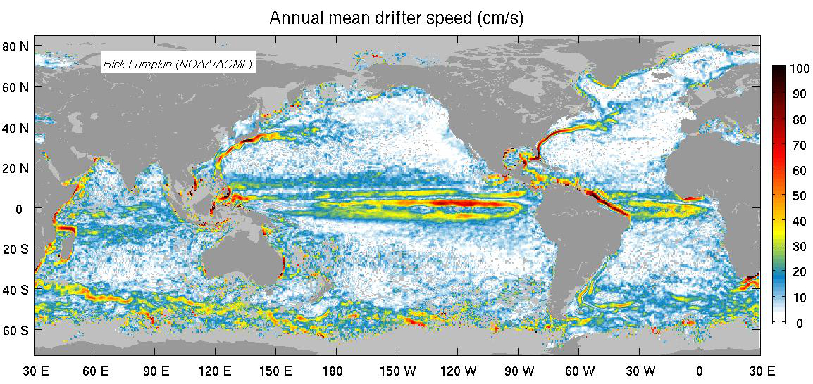
Global wind-driven circulation, gyre, western boundary currents
Speed = distance / time
http://www.aoml.noaa.gov/phod/dac/dac_meanvel.php
Notes:
Sharing of your information
We may share the information you give us with another government agency if your inquiry relates to that agency. In other limited circumstances, such as responses to requests from Congress and private individuals, we may be required by law to disclose information you submit. Before you submit personally identifiable information, such as on an online form, you will be advised as to the purpose and how the information will be used.
We may also share information collected during your visit with non-federal entities, but only if your inquiry requires accessing data from that external entity. All of our sites that require such external access will be clearly identified to help you make an informed choice.

Slide 19
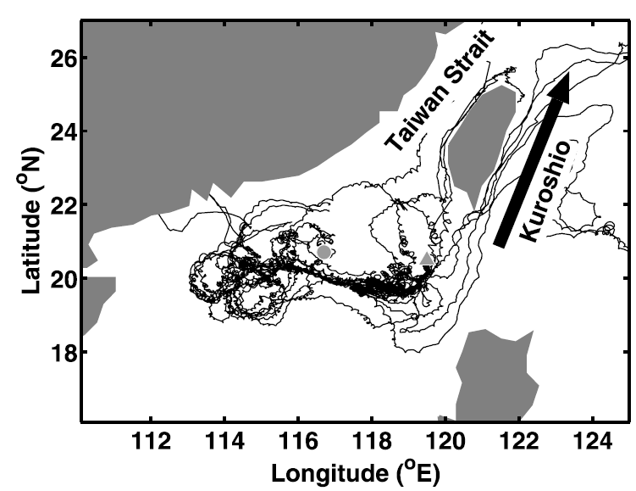
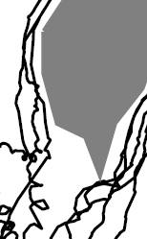
Eddy currents and inertial currents
Chow et al., 2008 JGR

Slide 20
Eulerian Measurements
Current Meters

Slide 21
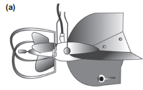
Current Meters

Slide 22
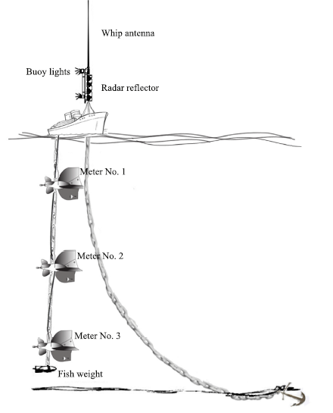
Setting the Current Meters

Slide 23
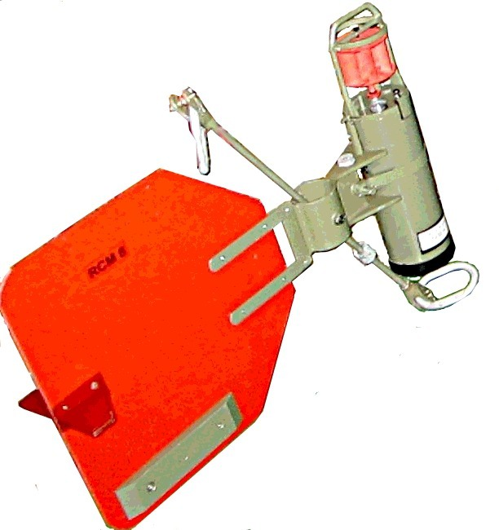
Current Meters
Rotor Current Meters (RCM):
time,u,v,temperature,salinity, pressure, tilting
https://en.wikipedia.org/wiki/Rotor_current_meter
Notes:
You are free to:
Share — copy and redistribute the material in any medium or format
Adapt — remix, transform, and build upon the material
for any purpose, even commercially.

Slide 24
Current Meters
Acoustic Current Meters
(ACM)
time,u,v,(w), temperature, salinity, pressure, tilting
https://dosits.org/wp-content/uploads/2017/07/FalmouthScientific_AcousticMeter111.jpg

Slide 25
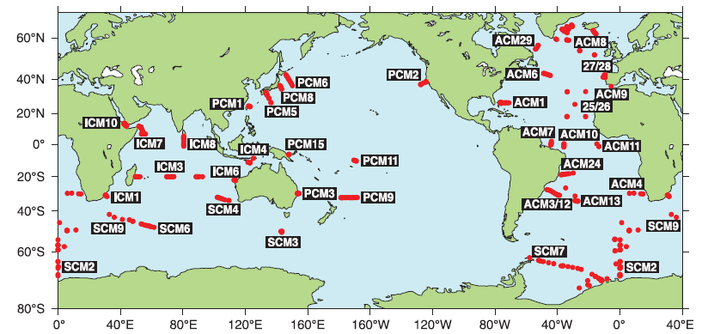
WOCE moored current meter arrays
WOCE: World Ocean Circulation Experiment

Slide 26
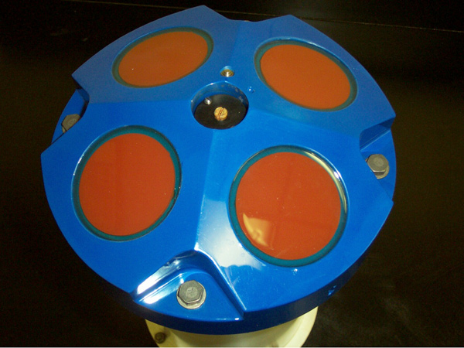
ADCP (Acoustic Doppler Current Profiler)
音鼓
time, pressure, tilting and
profiles of u,v,w
Give and get a specific sound
Using “Doppler Shift” principle
What is Doppler Shift? Please think?
Much better than previous Current Meters
Notes:
https://en.wikipedia.org/wiki/Acoustic_Doppler_current_profiler
Public domain

Slide 27
Doppler Shift/Effect in general
https://en.wikipedia.org/wiki/Doppler_effect

Slide 28
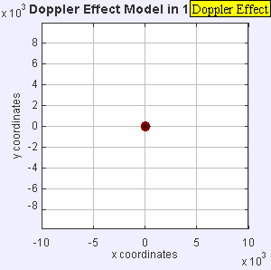
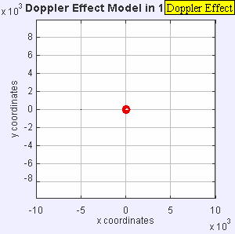
Doppler Shift/Effect
Stationary sound source
Moving sound source
https://en.wikipedia.org/wiki/Doppler_effect
Notes:
You are free to:
Share — copy and redistribute the material in any medium or format
Adapt — remix, transform, and build upon the material
for any purpose, even commercially

Slide 29
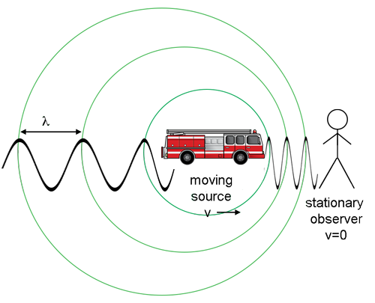
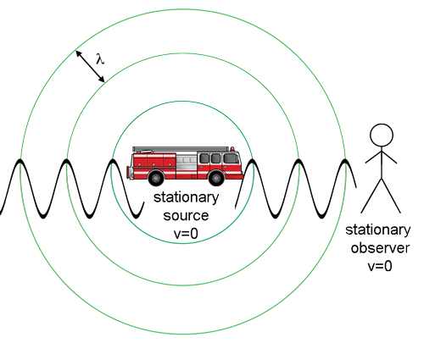
https://imagine.gsfc.nasa.gov/features/yba/M31_velocity/spectrum/doppler_more.html
Notes:
No copyright from NASA

Slide 30
Hearing the Doppler Effect (都卜勒效應)
https://www.youtube.com/watch?v=8WgSQlRymwE
Notes:
https://www.youtube.com/watch?v=I1ykNQijOC8

Slide 31
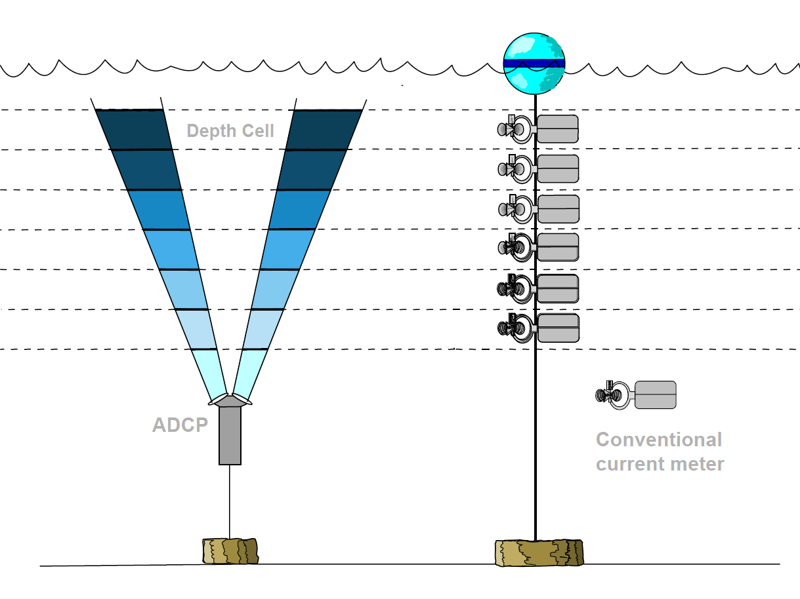

Source: IRD - Unite OBHI (Observatoires Hydrologiques et Ingenierie)

Slide 32
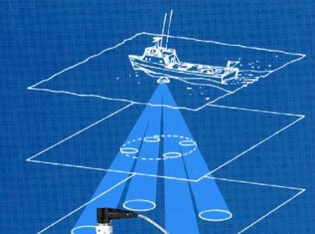
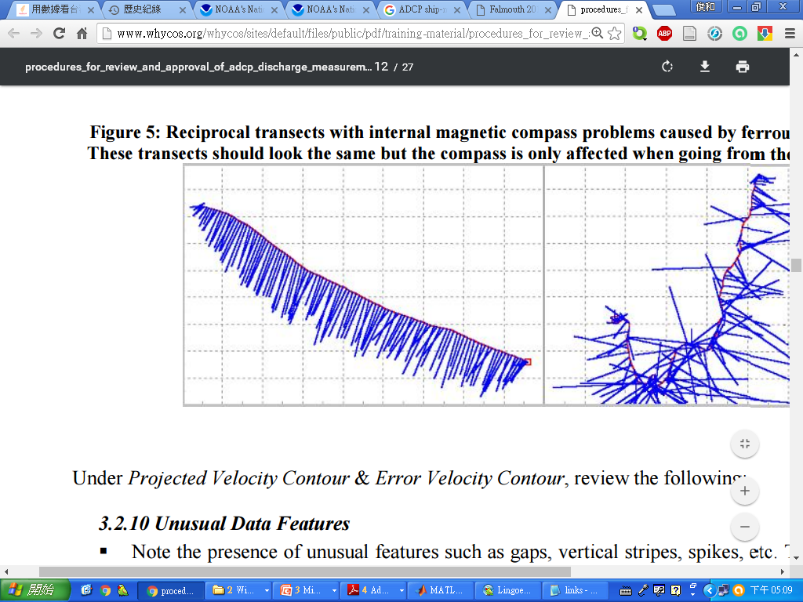
Ship-mounted ADCP
Notes:
http://www.whycos.org/whycos/sites/default/files/public/pdf/training-material/procedures_for_review_and_approval_of_adcp_discharge_measurements.pdf
http://www.soes.soton.ac.uk/teaching/courses/soes3018/2011/Group10/index.htm

Slide 33
HF Doppler radar systems
https://www.tori.narl.org.tw/TORI_WEB/CTORI/Data_Application/Codar/
https://www.tori.narl.org.tw/TORI_WEB/CTORI/Core_Facility/CODAR/

Slide 34
CTD

Slide 35
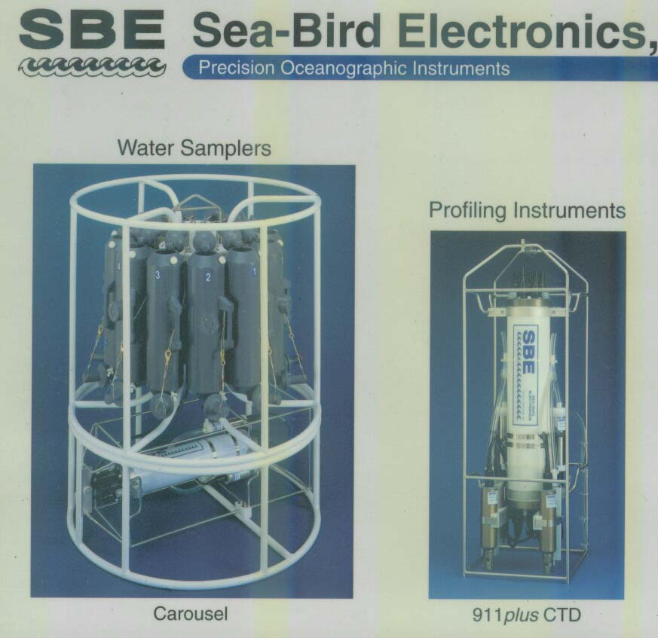
CTD
輪
盤
採
水
器
CTD
rosette
CTD
加
其
他
測
量
探
針

Slide 36
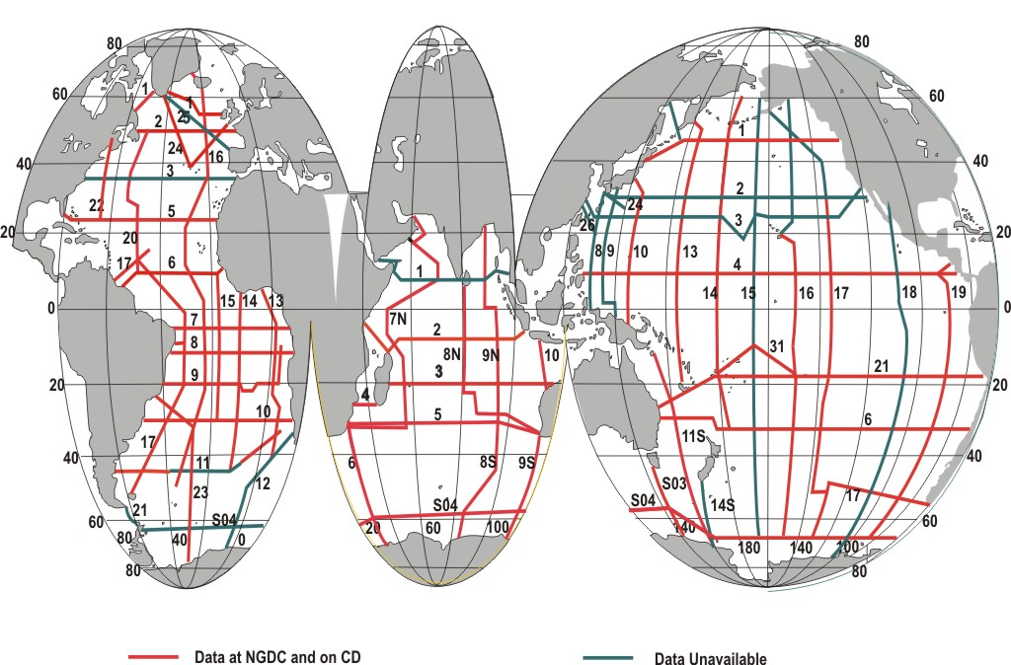
WOCE one-time hydrographic sections
Each line consisted of full-depth stations at typically 100 km spacing measuring temperature, salinity, nutrients, and a suite of chemical tracers. WOCE International Project Office.
WOCE: World Ocean Circulation Experiment
Notes:
https://www.nodc.noaa.gov/woce/woce_v3/wocedata_2/bathymetry/default.htm

Slide 37
XCTD
http://www2.kaiyodai.ac.jp/~hide/enversion1/instruments.html
http://tokyo2016.xbt-japan.org/document/presentations/XBT-SW5/Oct6/Kizu-XCTD.pdf

Slide 38
ARGO floats
http://www.jamstec.go.jp/ARGO/deepninja/
Similar to CTD, but AUTO:
Temperature (T), Salinity (S), Depth (D)

Slide 39
Argo global distribution
http://www.argodatamgt.org/Access-to-data/Argo-data-selection
Argo, Deep Ninja and bio-argo

Slide 40
Satellite observation

Slide 41
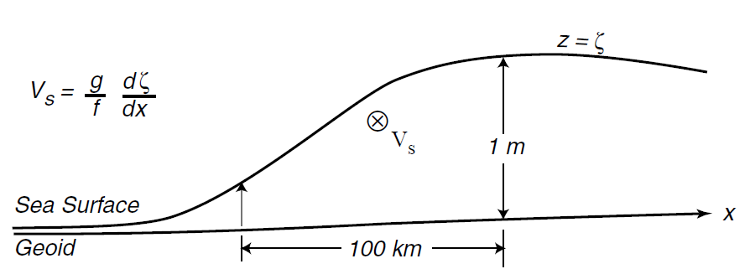
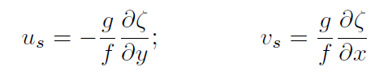
the equation of geostrophic currents (Application)
Surface Geostrophic Currents From Altimetry
https://marine.rutgers.edu/dmcs/ms501/2004/Notes/Wilkin20041104.htm
Notes:
No copyright found

Slide 42
What are geostrophic currents (地轉流)?
Discussion

Slide 43
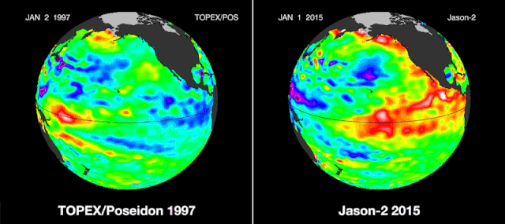
Sea surface height from space
http://earth.rice.edu/mtpe/hydro/hydrosphere/hot/enso/enso_ssh.html
Provided by NASA
Notes:
No copyright found

Slide 44
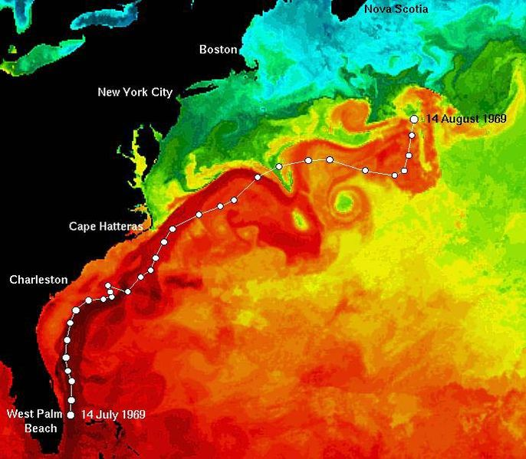
Sea surface temperature from space What do you see?
Notes:
I, the copyright holder of this work, hereby release it into the public domain. This applies worldwide. If this is not legally possible:
I grant any entity the right to use this work for any purpose, without any conditions, unless such conditions are required by law.
https://en.wikipedia.org/wiki/File:East_coast_sst_track.jpg

Slide 45
分組討論
哪種觀測海流的方法比較好? 為什麼?
這些觀測海流的方法有哪些優缺點?
觀測海流的方法目前有哪些問題(不足之處)?
分組3~4人, 用筆紙寫下討論結果後交上(註明姓名), 上臺報告
大家選出最好的一組
必須說服別人為什麼那組最好

Slide 46
More reading
http://www.physocean.icm.csic.es/IntroOc/contents-en.html
http://w3.oc.ntu.edu.tw/chap4/chap4.htm

Slide 47
Homework 3 (繳交期限: 2020/3/24) 遲交以50%計算
Try to google: When and where the earliest profiles of temperature and salinity were obtained?
Send your work in a docx word file (filename: hw03_yourname.docx)
to https://driveuploader.com/upload/lVD4ycOKfP/
{need your laptop next lesson}

